Slide 1
Free Time of College Students
Andrew Steele
Raditya Fahritama
Applied Statistics (Fall 1, 2021)

Slide 2

Introduction
The way that students spend their time out of the classroom is important as it effects how they perform in class, and ultimately if they pass or fail their classes as a result of time spent studying or time used in other ways. We decided to collect and analyze data that we have collected from students to see how they spend their time outside of class and what effect it has on their GPA. Also, as many students are working in collage in order to be able to afford it, we are attempting to see if there is a correlation between students with full time jobs and the effects that those jobs have on grades.

Slide 3
Context and Problem
The amount of time students spend outside of classes has important role to their school life. We are trying to analyze the data that we have collected through a survey for students.
The objectives of this project are, we are trying to find out whether the amount of free time spent and how it was used outside of classes will affect student’s GPA.
And we are trying to understand whether there is a correlation between student’s who got a full-time job and their GPA.

Slide 4
Overview of Solution / contributions
Based on the survey data collected, we try to find how most of students spend their free time outside of class using the hypothesis method to see if it is done studying for class.
We try to find if there is a linear correlation between students who work full time and time spent studying for class.
Find if the way students are spending their time affects their grades.
The data will be survey driven and will need to be reviewed with that in mind that it is voluntary data.
Responsibilities:
Raditya: Survey questions, data collection and processing, Correlation, Data visualization.
Andrew: Descriptive Statistics, Hypothesis testing, credibility of the voluntary sample responses.

Slide 5

Data Collecting and Preprocessing
Data were collected through a simple survey that asks how many hours they spent for classes, studying, and doing other activities. The survey was posted on online forum. And the survey targeted students who were still in college or graduate school. And then after we got the data from the survey. We assigned values for every data. And process them using technology. We analyzed the data to check whether there is correlation, checked the hypothesis. And then we visualized the data we obtained. The response we got is 48 responses.
The data is voluntary data. So, it might be not accurate.

Slide 6
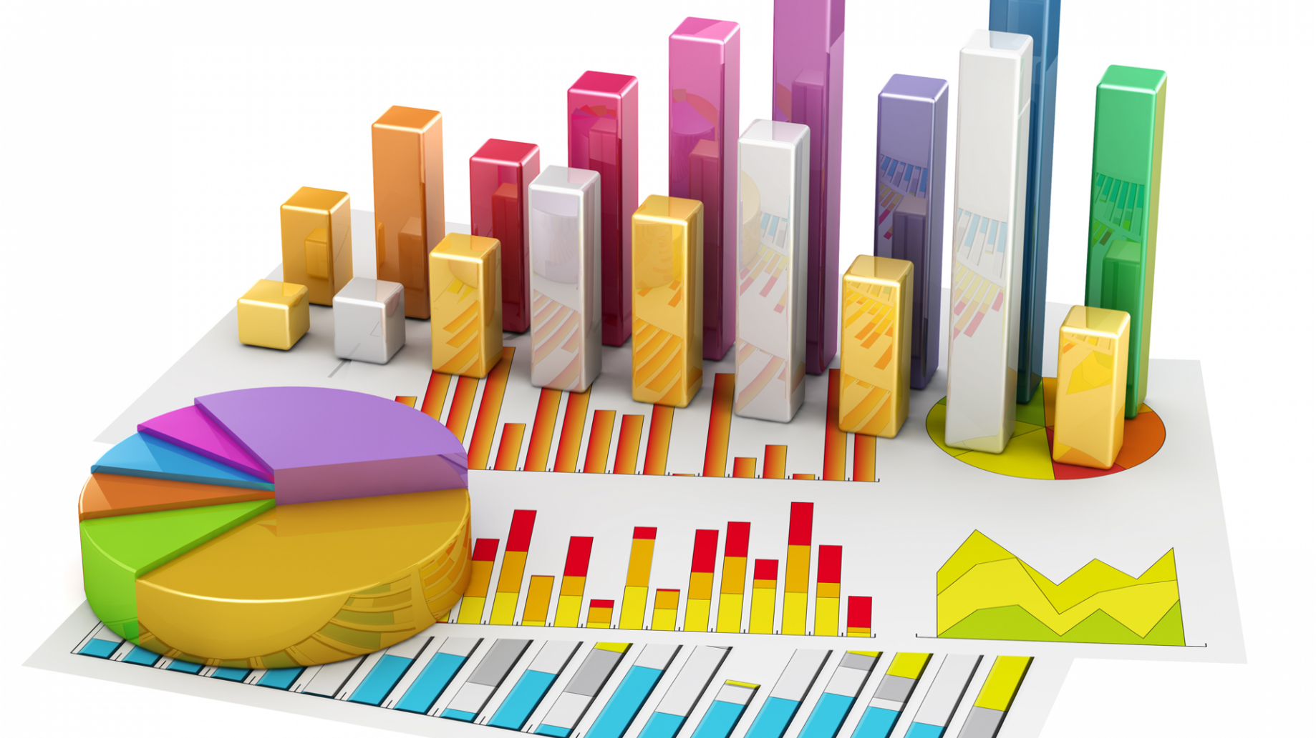
Statistical Methods
Descriptive Statistics:
We collected the data through survey. And then we processed the data. We tried to find the Mean and Median of GPA. And then we checked whether the GPA is normally distributed or not. After that, we checked if there are correlations between GPA and other parameters.
Inferential Statistics:
We claim that the amount of time student spent studying is
less than half of their free time outside work and class. And we tested
our claim through hypothesis testing.

Slide 7
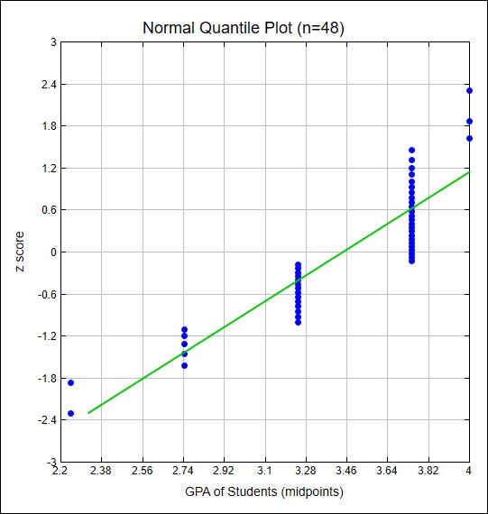
Assessing Normality
Normal Quantile Plot of GPA
The points lie reasonably close to the straight
line. So, the data is approximately normally
distributed.

Slide 8
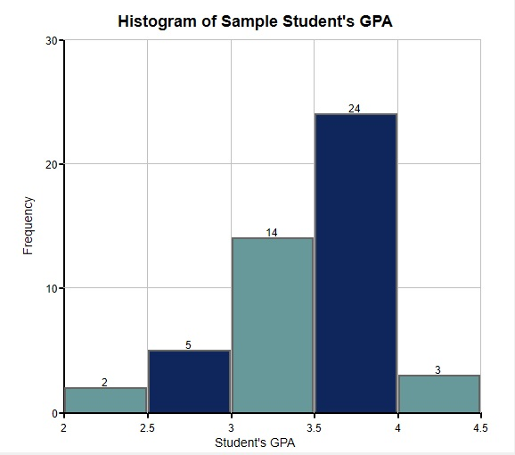
Assessing Normality
Histogram of Student’s GPA
The histogram goes from low to high, and then
low again. So, we conclude that the
data is approximately normally distributed.

Slide 9
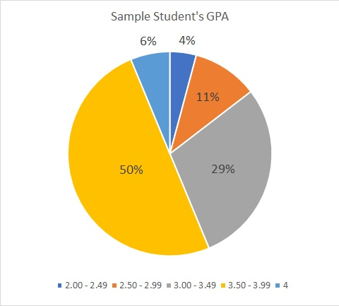
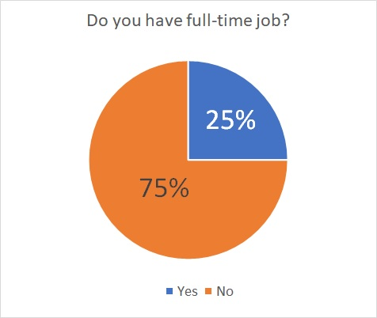
Evaluations – Performance – comparing
Pie Chart

Slide 10
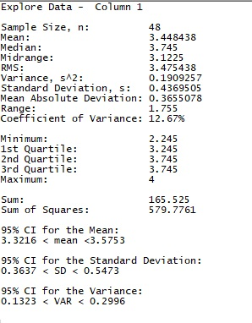
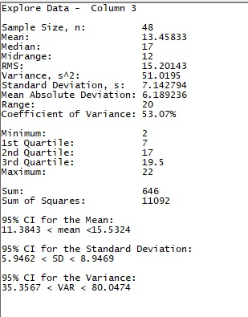
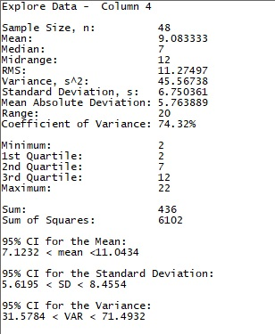
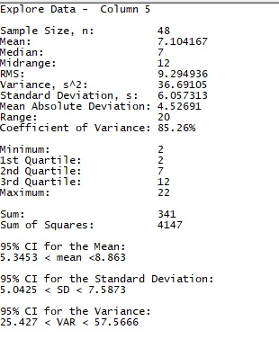
Evaluations – Performance – comparing
Explore Data - Descriptive Statistics
GPA Hour of Classes Hour of Studying Hour of Hanging Out
Mean: 3.448 Mean: 13.458 Mean: 9.083 Mean: 7.104
Median: 3.745 Median: 17 Median: 7 Median: 7

Slide 11
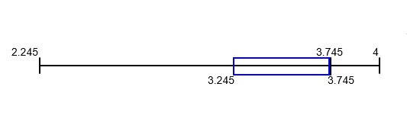
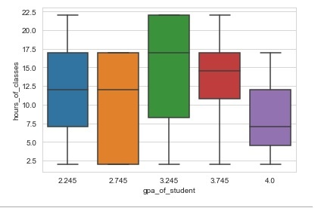
Evaluations – Performance – comparing
Boxplot of Student’s GPA
Boxplot of Student’s GPA and hour of classes

Slide 12
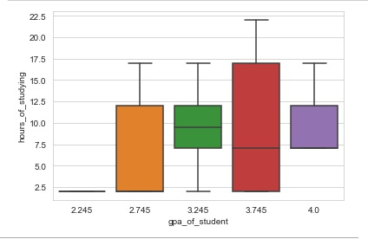
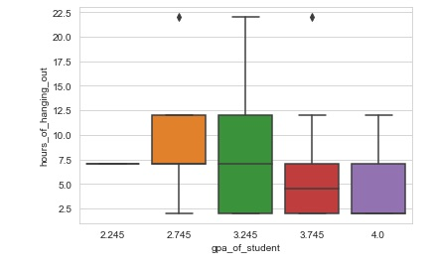
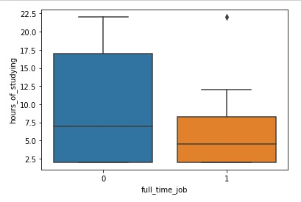
Evaluations – Performance – comparing
Boxplot of Student’s GPA Boxplot of Student’s GPA Boxplot of Student’s job status
and Hour of Studying and Hour of Hanging Out and Hour of Studying

Slide 13
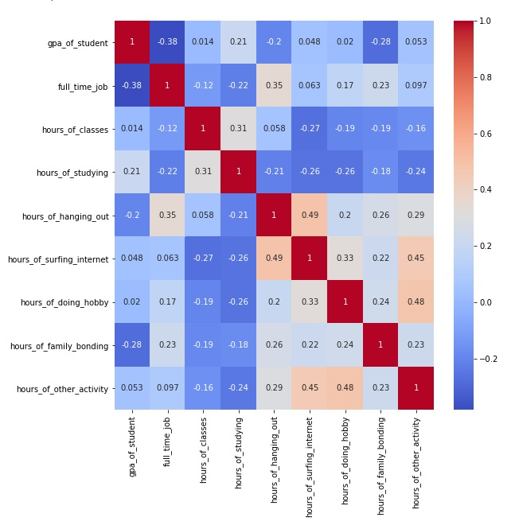
Evaluations – Performance – comparing
Correlation Heatmap

Slide 14
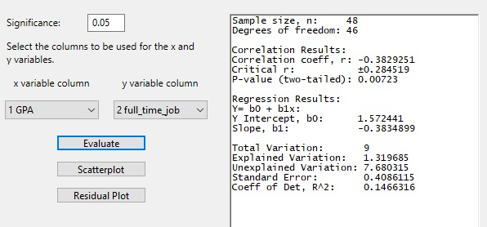
Lessons Learned and Perspectives
Correlation between Student’s GPA and whether they have full-time job or not.
P-Value: 0.00723 , significance value: 0.05
r: -0.38 , critical r: 0.284519
P-Value is smaller than significance value. And r is bigger than critical r. So, there is a correlation. Negatively correlated.

Slide 15
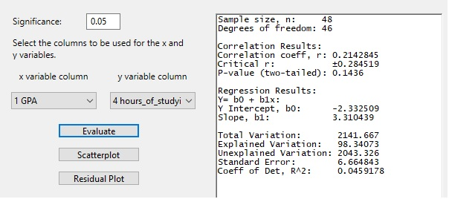
Lessons Learned and Perspectives
Correlation between Student’s GPA and hour of student studying for next classes.
P-Value: 0.1436 , significance value: 0.05
r: 0.21 , critical r: 0.284519
P-Value is bigger than significance value. And r is smaller than critical r. So, there is no correlation.

Slide 16

Lessons Learned and Perspectives
Correlation between Student’s GPA and hour of hanging out with their friends.
P-Value: 0.17445 , significance value: 0.05
r: -0.1992988 , critical r: 0.284519
P-Value is bigger than significance value. And r is smaller than critical r. So, there is no correlation.

Slide 17
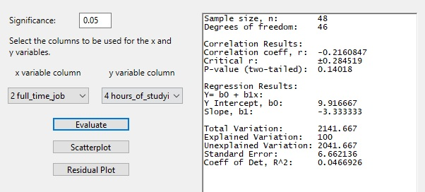
Lessons Learned and Perspectives
Correlation between whether student has full-time job and hour of studying.
P-Value: 0.14018 , significance value: 0.05
r: -0.22 , critical r: 0.284519
P-Value is bigger than significance value. And r is smaller than critical r. So, there is no correlation.

Slide 18
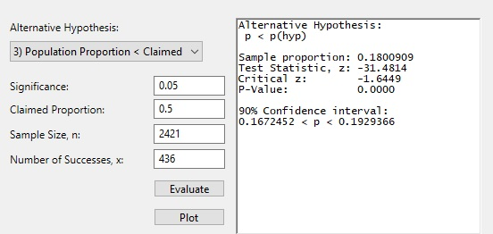
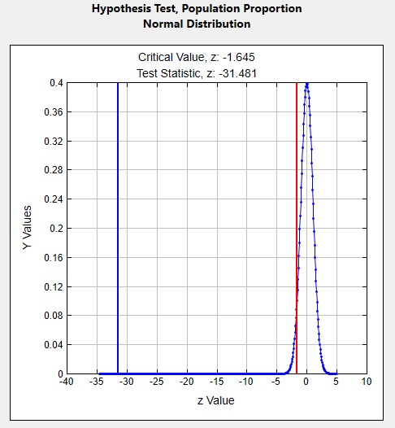
Lessons Learned and Perspectives
Hypothesis Testing Result
Because the z value is far beyond the limits of the normal standard distribution the P-Value is +00000. Because the P-value is less than the α = 0.05 which is less than the significance level we reject the null hypothesis.
Because we reject the null hypothesis, we support the alternative hypothesis of p<0.5. We conclude that there is sufficient sample evidence to support the claim that more than half of student’s free time is spent on other items besides studying for class

Slide 19
Lessons Learned and Perspectives
Conclusion based on the sample:
There is a correlation between Student’s GPA and whether if they have a full-time job or not. And it is negatively correlated.
There is no correlation between Student’s GPA and free time hour spent studying for next classes.
There is no correlation between Student’s GPA and free time hour spent hanging out with their friends.
There is no correlation between whether student has full-time job or not and the amount of free time spent by studying
Based on the hypothesis testing, The P-Value is lower than the significance value. So, we reject the null hypothesis.
We conclude that there is sufficient sample evidence to support the claim that more than half of student’s free time is spent on other items besides studying for class

Slide 20
Lessons Learned and Perspectives
Some things that can be improved:
larger sample size so that there is a larger pool that samples can be collected.
The survey could also could have been left up longer.
The class sizes could be smaller in size and there be more in order to collect more accurate information
The survey should be limited to a particular area or even just one University so that students from the same area are being compared.

Slide 21
Thank You!

